Slide 1
High-Efficient PPS solution for USB Fast charging consumer applications.
Fahad Ahammad.
Engineer,
Central Applications.
Notes:
This is the light cover slide option.

Slide 2
USB PD 3.0 system solution for Sink/DRP (PD and PPS Charging)
PD Charging
Potential Applications for
PPS Fast charging:
Suitable for all consumer
applications for effective heat
management.
Mobile Phones
Tablets/Notebooks
Potential Applications for
PD charging:
Almost all consumer applications
Including VR headset, Cameras,
Notebooks, mobile phones, drones,
power banks and so on.
VBUS
MAX77986
Charger
VSYS
CC1
I2C
CC2
MAX77958
PD controller
GPIO
USB
Type C
input
LTC7825
2:1 SCC
I2C
MAX32660
MCU
I2C
MAX17260
Fuel Gauge
1-cell
PPS Fast Charging

Slide 3
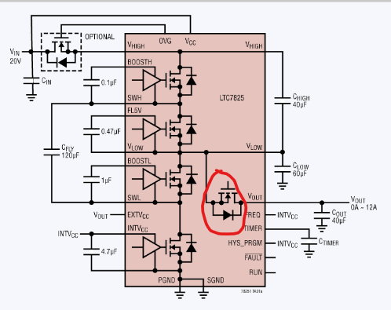
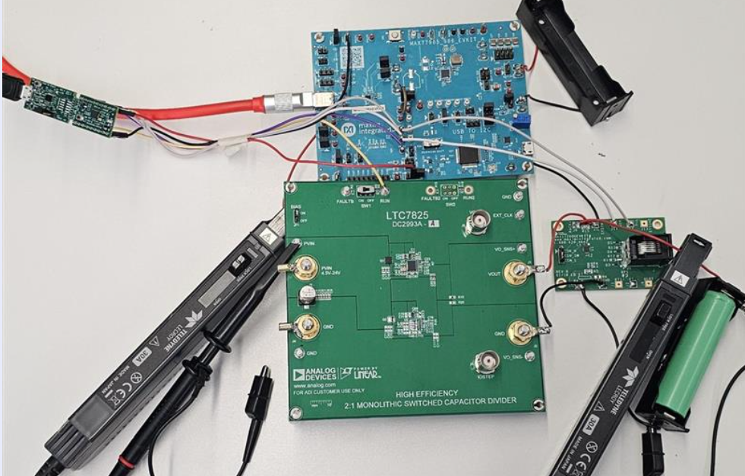
How to do PPS charging then?
We came across the switched capacitor converter (LTC7825) which has an inter switch in between the SCC topology and the output
i.e. between VLOW and VOUT as indicated in Figure 3.
This switch will block the reverse voltage from the battery, if there is no input supply
which is ideal for our use case.
After interconnecting the EVKITs (consisting of MAX77958, MAX77986, MAX17262, DC2993A,
MAX32660), a CC-CV charging state machine which works for PPS mode has been
developed as indicated in the next page.
Interrupt based detection and charging has been employed using the code.
The code can support normal PD charging and use MAX77986 buck converter
in case if the power adapter does not support PPS.
Automatic detection of PPS PDO is available in case, if the power adapter has
PPS feature.
Note: Fuel gauge is used to measure the battery voltage and battery current
which is required to develop PPS CC-CV Algorithm.
Figure 3
Figure 4

Slide 4
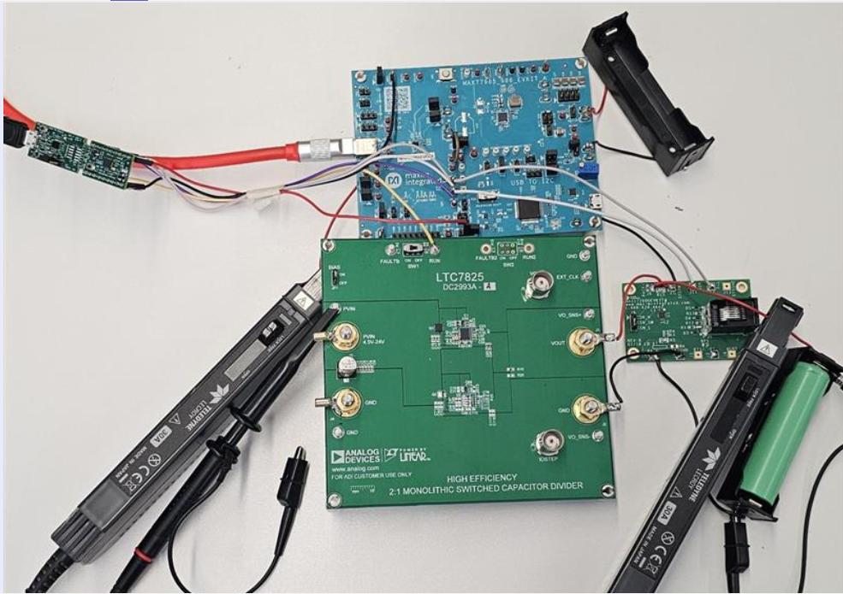
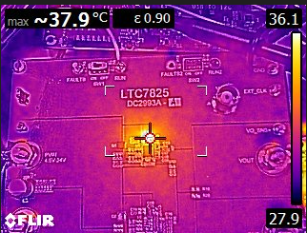
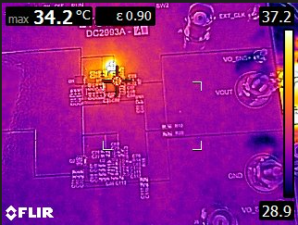
Thermal Comparison between PD and PPS charging solution
Thermal test on LTC7825 SCC (used for PPS Charging)
The thermal testing for LTC7825 (switched capacitor converter)
for a charging current of 5.5A was tested.
The results are as indicated below:
The capacitors placed outside is heating up to 37.9 degree Celsius.
The IC heating till 34.2 degree Celsius.
System Setup
PD charging
section
PPS fast
charging
section
Focused on capacitors
Focused on ICs

Slide 5
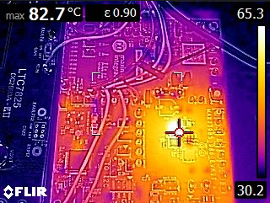
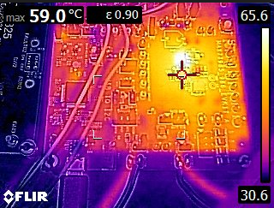
Test and Results
Thermal test on MAX77986 Buck Charger (used for PD charging)
Thermal testing of MAX77986 switching charger at a charging current of 5.5A
MAX77986 IC heating up to 59 Degree Celsius.
Area near MAX77986 heating up to 82.7 Degree Celsius

Slide 6

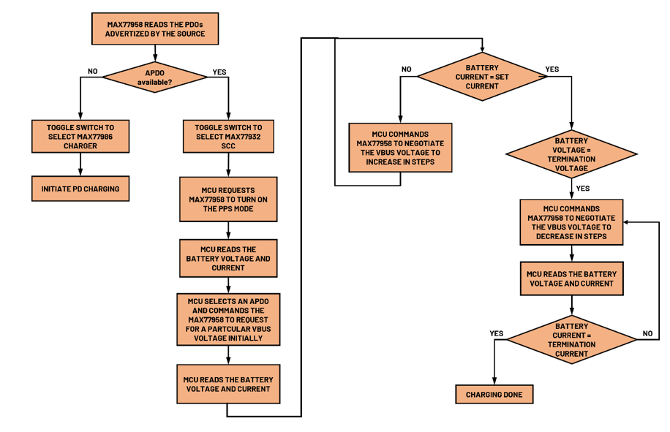
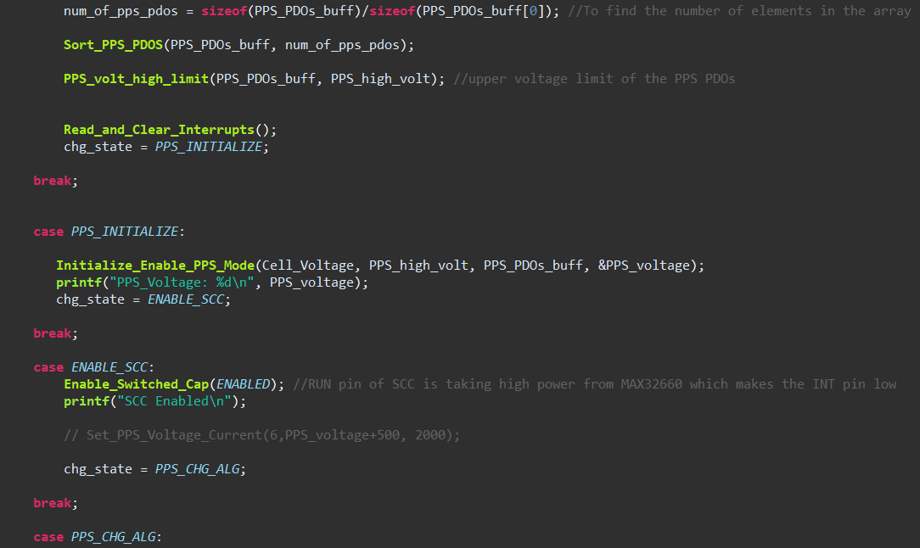
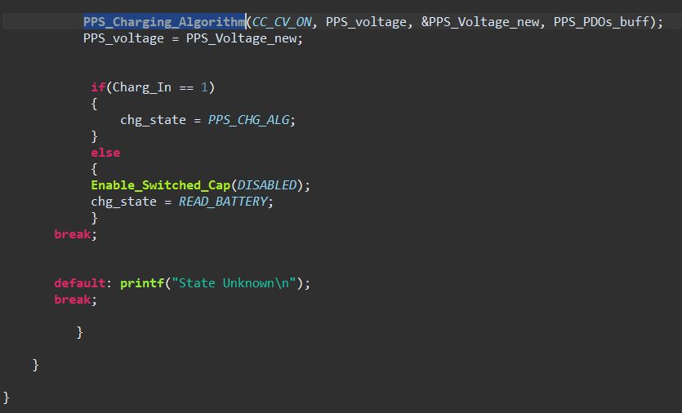
PPS Charging CC-CV state machine
PPS charging State machine

Slide 7
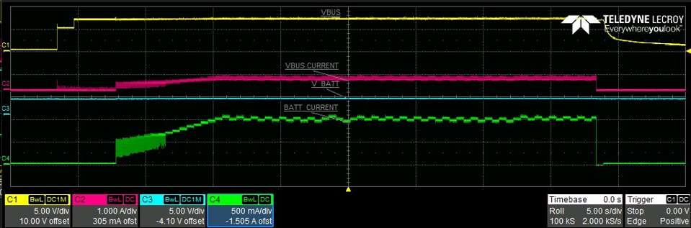
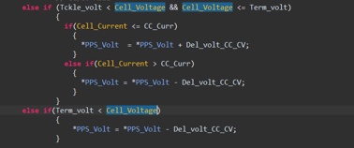
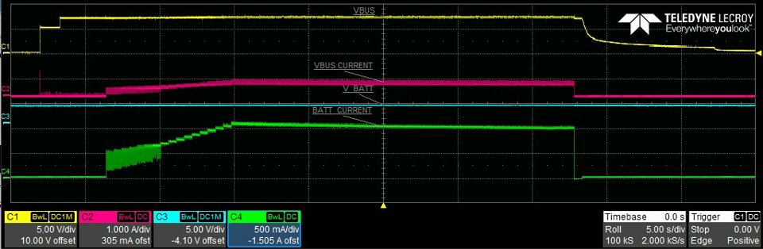
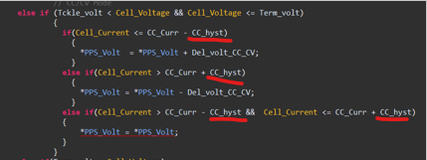
Results and Observations
When a power adapter with PPS feature is inserted into the system and the charging current is set at 1A
Issue: From the above scope details we can see that the charging current is reached at 1A by continuous negotiation using MAX77958
But there is current fluctuation issue after reaching the target current (1A)
Resolution: Resolved by providing an hysteresis in the charging algorithm, results are as below:
VBUS/USB voltage
VBUS/USB input current
Battery voltage
Battery/Charging current
Before providing Hysteresis
VBUS/USB voltage
VBUS/USB input current
Battery voltage
Battery/Charging current
After providing Hysteresis

Slide 8
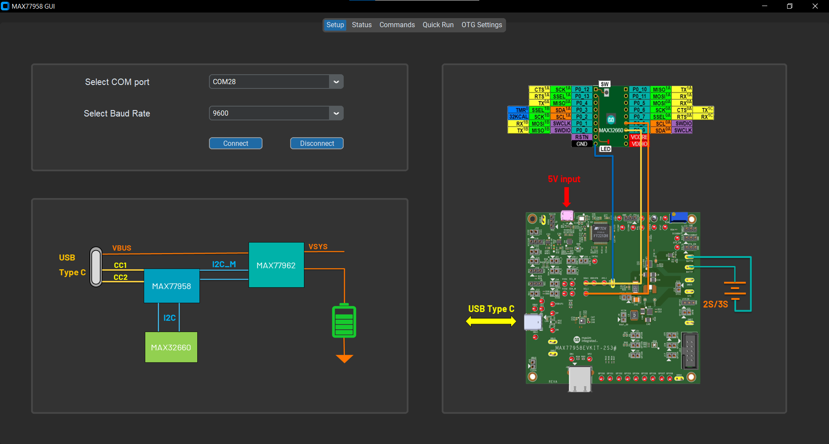
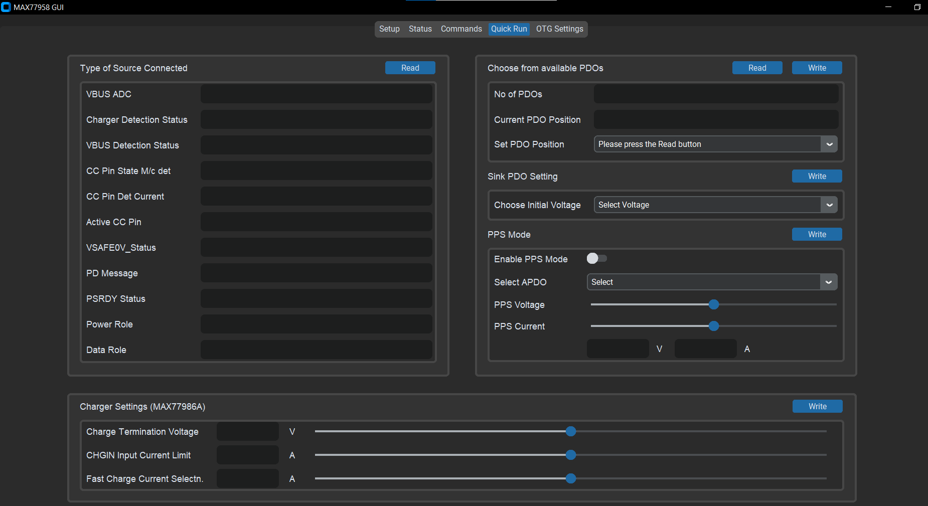
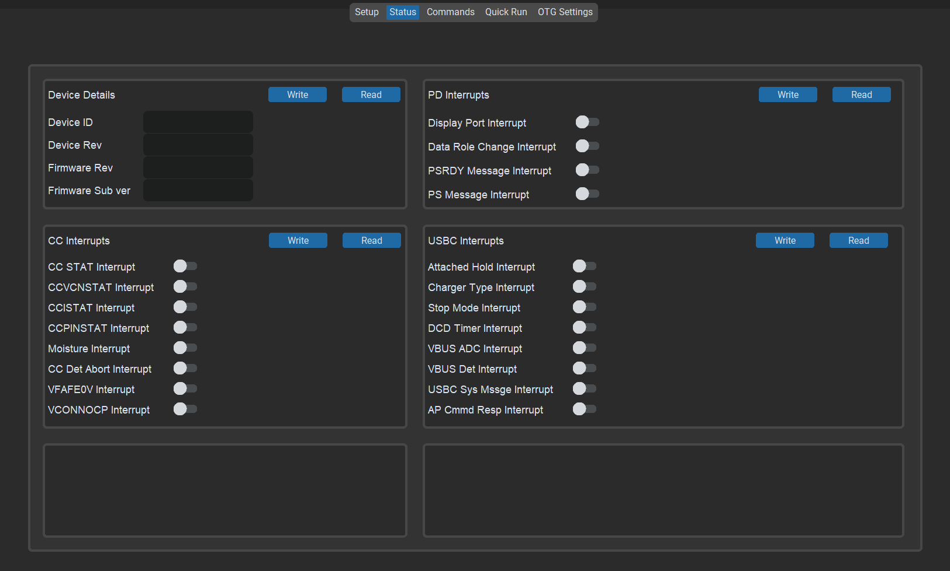

GUI functionality

Slide 9
Conclusion/Observation
Nowadays Mobile phones and tablets are more powerful and consume lot of power for operation.
To last longer they are equipped with larger capacity batteries.
Therefore, charging current needs to be increased to reduce the charging time keeping the heat
management in mind to protect sensitive electronics in the system.
With the advent of USB PPS mode, direct charger such as switched capacitor can be employed
which has higher efficiency compared to normal switching regulators.
This study has proven the PPS charging solution superior heat management over PD charging solution
for same charging current.
Thus, PPS can be implemented effectively for fast charging in consumer electronics like
mobile phones, tablets.

Slide 10
THANK YOU

